Slide 1
Today’s Class
6:00PM – 7:30PM: Working in a Reproducible Environment:
R Projects, R Markdown, R Notebooks
Creating and editing R Markdown files
7:45PM – 9:00PM: Importing Data with Base R and the Tidyverse
9:00PM – 9:50PM: Coding Exercises (importing data to begin your midterm project)

Slide 2
working in a reproducible environment
Visualize
Get
Clean
Transform
Communicate
Model
Understand
Program
☨A modified version of Hadley Wickham’s analytic process

Slide 3
“Organization is what you do before you do something, so that when you do it, it is not all mixed up.”
- A. A. Milne

Slide 4
the basic idea
Topic | Description
R project | ?
R Markdown | ?
R Notebook | ?

Slide 5
the basic idea
Topic | Description
R project | Conveniently organizes files pertaining to specific analytic projects
R Markdown | Allows user to combine prose, code, and metadata into one file to increase reproducibility and reporting capabilities
R Notebook | An R Markdown document that allows for independent and interactive execution of code chunks. Great for sharing.
All 3 have the goal of streamlining your workflow!

Slide 6

RStudio projects

Slide 7
using projects
RStudio projects make it straightforward to divide your work into multiple contexts, each with their own:
working directory
workspace
history
source documents

Slide 8
how to create a project
File ≫ New Project

Slide 9
so what’s different?

Slide 10
so what’s different?
When a project is opened:
A new R session is started
The .Rprofile file in the project's main directory is sourced
The .RData file in the project's main directory is loaded
The .Rhistory file in the project's main directory is loaded
The current working directory is set to the project directory
Previously edited source docs are restored to the editor tab
Other RStudio settings (active tabs, splitter positions, etc) are restored
We can also work with multiple projects at one time

Slide 11
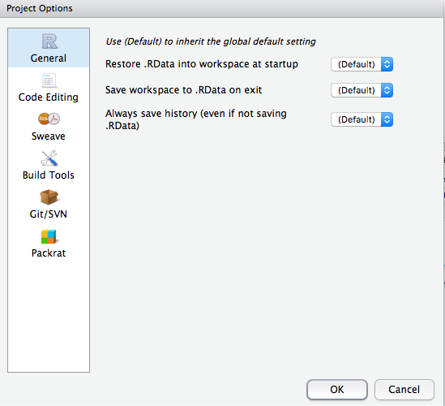
Set project options
Tools ≫ Project Options

Slide 12
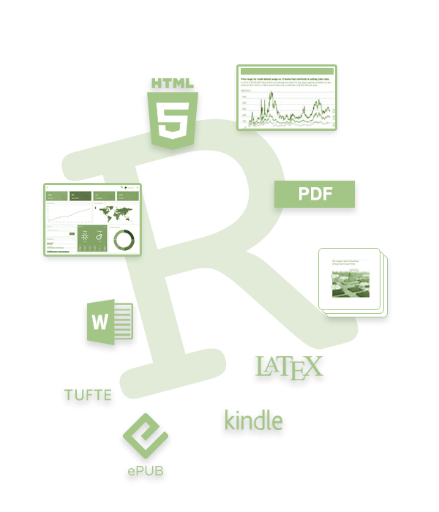
R Markdown

Slide 13
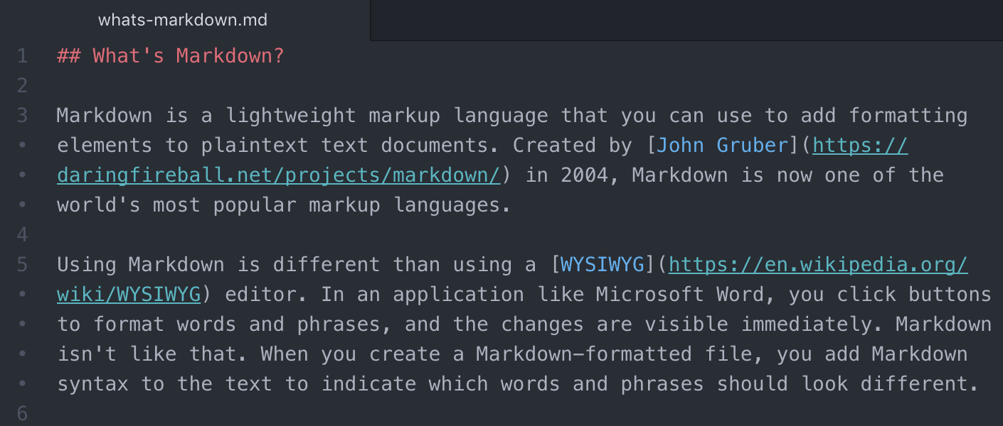
What is Markdown?
A markup language used to format plain text
Used by
Facebook chat
Reddit
Skype
R
Python
And MANY others!

Slide 14
using r markdown
R Markdown, a file format that leverages Markdown, allows you to turn your analyses into high quality documents, reports, presentations, and dashboards
HTML
PDF
LaTex
ePUB
etc.

Slide 15
how does it work?

Slide 16
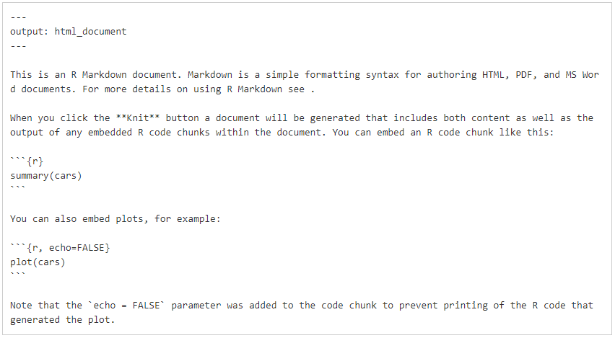
What Do R Markdown Files Look Like?
.Rmd (R Markdown files) typically contains three things:
(optional) YAML header
Chunks of R code
Text mixed with simple formatting, leveraging Markdown

Slide 17
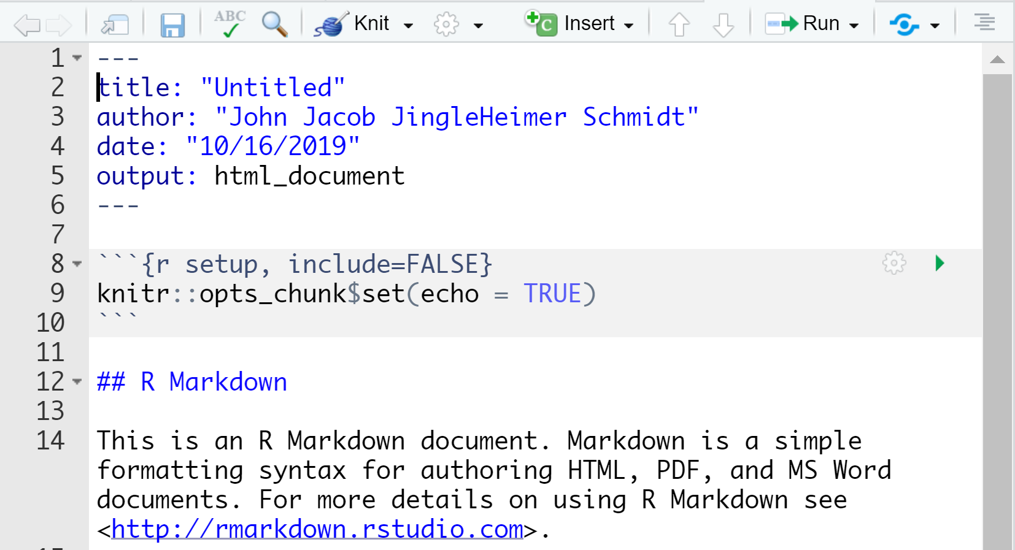
Running code Chunks and Entire R Markdown Files
Run individual code chunks with the green run icon
Produce a complete report by pressing the Knit button
“Knitting” a document means to execute all code chunks and produce a markdown document

Slide 18
Let’s Practice!
You’ll need three files open for this activity.
Create a new .Rmd file: RMarkdown Demonstration Report.Rmd
Open from today’s Week 2 folder that you downloaded:
RMarkdown Demonstration Text.docx
RMarkdown Demonstration Code.R

Slide 19
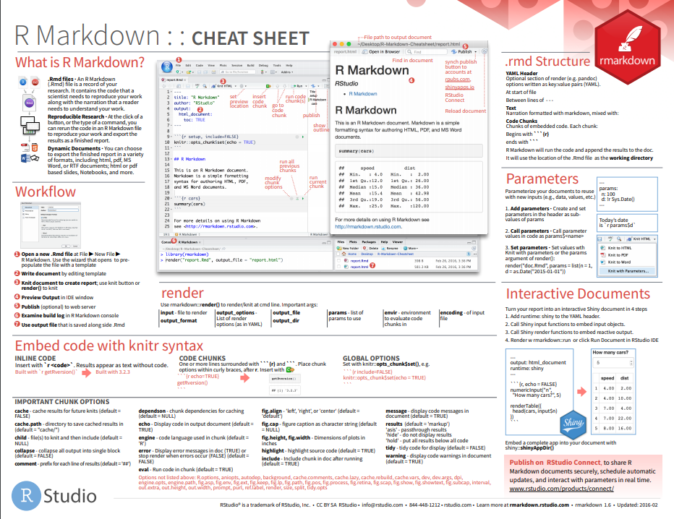
R Markdown Cheat Sheet!
RStudio creates cheat sheets to help you remember everything!
The R Markdown cheat sheet will help you today!
To find RStudio’s cheat sheets, you can:
Google it
In RStudio, go to Help→Cheatsheets

Slide 20
How to: Format Plain Text
Place one asterisk or one underscore on each side of a word/phrase to italicize it
Place two asterisks or two underscores on each side of a word/phrase to bold it
Place backticks around an R command to create inline code (or around a word to monospace it)
End a word/phrase with ^2^ for superscript or ~2~ for subscript
# italicize a word/phrase
*italic*
_this phrase is in italics_
# bold a word
**hey I’m bold and awesome**
__bold__
# inline code chunks with backticks
`package_name` # this appears in monospaced font
`nrow(iris)` # this will show a number after knitting
# superscript and subscript
superscript^2^
subscript~2~

Slide 21
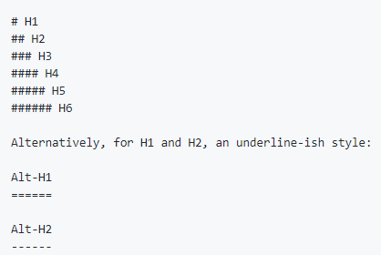
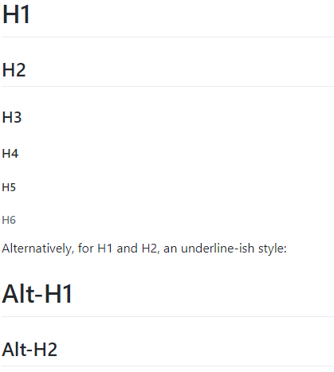
How to: Format Headers
The number of # signs dictate how large the header is

Slide 22
How to: Links and Images
# show a URL as a hyperlink
<http://whatacoolexample.com>
# show a hyperlink with a linked phrase
[OMG this text will show instead of the URL](http://whatacoolexample.com)
# caption for a picture
![cute dog pic](/file/location/cutedogpic.png)

Slide 23
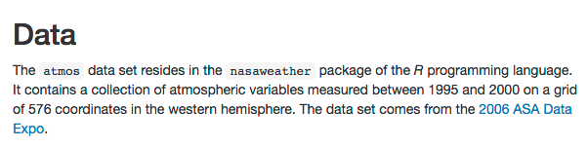
Your turn!
From the Word document, copy all text beginning with # Data and ending with “…2006 ASA Data Expo” and paste the text into your .Rmd file.
Turn the line that begins with "Data" into a second level header.
Change the words atmos and nasaweather into a monospaced font suitable for code snippets.
Make the letter R italicized.
Change "2006 ASA Data Expo" to a link that points to http://stat-computing.org/dataexpo/2006

Slide 24
Solution
Turn the line that begins with "Data" into a second level header.
## Data

Slide 25
Solution
Change the words atmos and nasaweather into a monospaced font suitable for code snippets.
The `atmos` data set resides in the `nasaweather` package

Slide 26
Solution
Make the letter R italicized.
*R*

Slide 27
Solution
Change "2006 ASA Data Expo" to a link that points to http://stat-computing.org/dataexpo/2006
The data set comes from the [2006 ASA Data Expo](http://stat-computing.org/dataexpo/2006).

Slide 28
How to: Lists
# numbered lists (don’t forget the space after the dot)
One
Two
Three
# bulleted list with sub points (two spaces in front for sub points)
# can use *, -, or + symbol for bullet points
* eggs
* milk
- skim
- full fat
* bread
* (chocolate to eat on way home so bae doesn’t eat it)
# can mix types
1. it’s
2. a
+ hi
+ there
3. mixed list

Slide 29
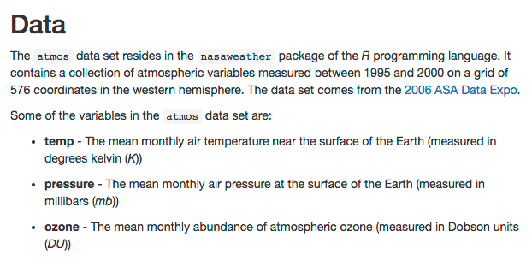
Your Turn!
Turn the text into a bulleted list with 3 bullets: temp, pressure, ozone.
Make temp, pressure, ozone bold at the start of each entry.
Make K, mb, and DU italicized at the end of each entry.

Slide 30
Solution
Turn the text into a bulleted list with 3 bullets: temp, pressure, ozone.
* temp –
* pressure –
* ozone –

Slide 31
Solution
Make temp, pressure, ozone bold at the start of each entry.
* **temp** -
* **pressure** -
* **ozone** -

Slide 32
Solution
Make K, mb, and DU italicized at the end of each entry.
*K*
*mb*
*DU*

Slide 33
How to: Formulas
Multiple markdown syntaxes exist to place inline formulas and to display formulas (centered on page on its own line)
LaTeX formulae:
Surround formula with one $ sign to create an inline formula
Surround formula with two $ signs to display a formula
# create inline formula
$\forall x \in X, \quad \exists y \leq \epsilon$
# create displayed formula
$$\cos (2\theta) = \cos^2 \theta - \sin^2 \theta$$

Slide 34
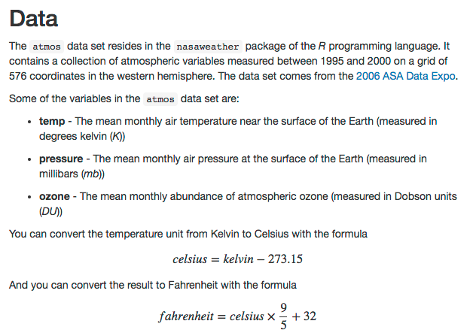
Your Turn!
Create a function that illustrates the conversion from Kelvin to degrees Celsius:
celsius = kelvin - 273.15

Slide 35
Solution
Create a function that illustrates the conversion from Kelvin to degrees Celsius:
celsius = kelvin - 273.15
$$celsius = kelvin - 273.15$$

Slide 36
How to: What Is A Code Chunk?
A code chunk runs code (this is a markdown principle in general, not just for R Markdown)
Necessary to run code in an R Markdown file
Three ways to insert code chunk:
Keyboard shortcut! Ctrl + Alt + I
“Insert” button in the toolbar
Manually typing ```{r} ```
# code chunk example
# What will this code chunk do?
```{r}
summary(cars)
```

Slide 37
How to: Code Chunk Names
Can give code chunk an optional name
Advantages of naming code chunks:
Navigate to specific code chunks easily with the drop-down code navigator in the bottom-left of the script editor
Graphs made from chunks will be easier to use elsewhere
Can cache chunks to knitting time later
Place code chunk name inside {} after the letter r
# code chunk example
# What will this code chunk do?
```{r cars-summary}
summary(cars)
```

Slide 38
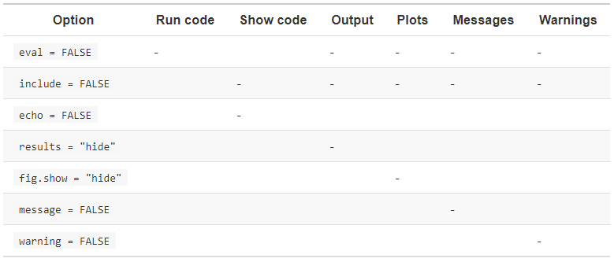
How to: Code Chunk options
Customize code chunks with options that are placed in the chunk header
There are over 60 options! The most important options are below.
# code chunk example with option
# What will this code chunk option do?
```{r cars-summary, echo = FALSE, warning = FALSE}
summary(cars)
```

Slide 39
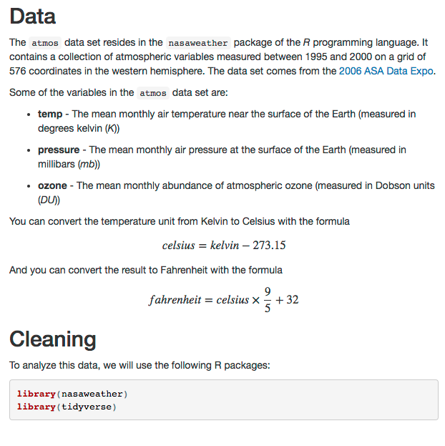
Your Turn!
Add code chunk 1 (R packages)
Set message=FALSE so messages are not produced in your report when you load the packages
Add code chunk 2 (year being analyzed)
Set echo=FALSE so this code runs but is not visible to the reader

Slide 40
Solution
Add code chunk 1 (R packages)
Set message=FALSE so messages are not produced in your report when you load the packages
```{r message = FALSE}
library(nasaweather)
library(tidyverse)
```

Slide 41
Solution
10. Add code chunk 2 (year being analyzed)
Set echo=FALSE so this code runs but is not visible to the reader
```{r echo = FALSE}
year <- 1995
```

Slide 42
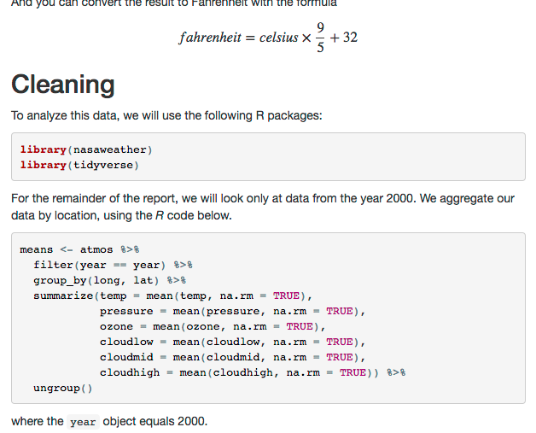
Your turn!
Add an inline code chunk to reference the year being analyzed (code chunk 3 & 5)
Add code chunk 4 and make it visible to the reader
Knit to HTML, change the year being analyzed to 2000 and re-knit document. Note how the inline code chunks change.

Slide 43
Solution
Add an inline code chunk to reference the year being analyzed (code chunk 3 & 5).
data from the year `r year = 2000` `r year`

Slide 44
Solution
Add code chunk 4 and make it visible to the reader.
```{r message = FALSE, warning = FALSE}
means <- atmos %>%
filter(year == year) %>%
group_by(long, lat) %>%
summarize(temp = mean(temp, na.rm = TRUE),
pressure = mean(pressure, na.rm = TRUE),
ozone = mean(ozone, na.rm = TRUE),
cloudlow = mean(cloudlow, na.rm = TRUE),
cloudmid = mean(cloudmid, na.rm = TRUE),
cloudhigh = mean(cloudhigh, na.rm = TRUE)) %>%
ungroup()
```

Slide 45

Solution
Knit to HTML, change the year being analyzed to 2000 and re-knit document. Note how the inline code chunks change.

Slide 46
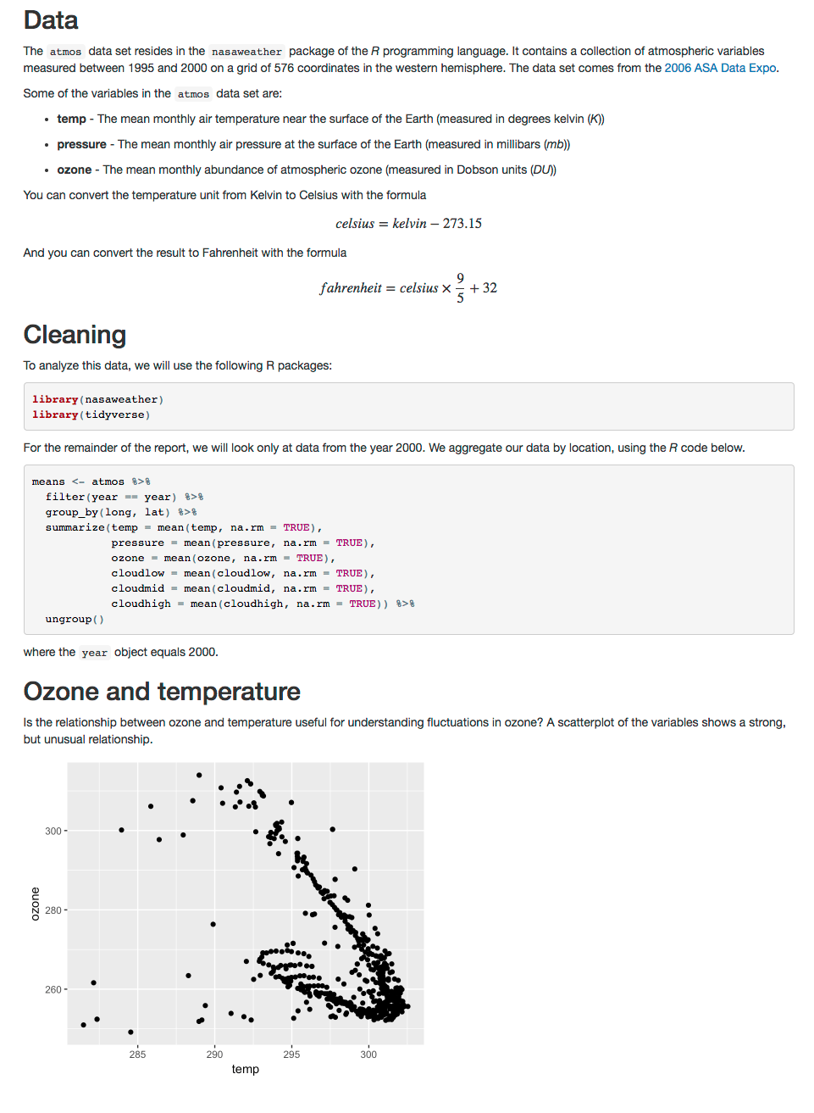
Your Turn!
14. Add text and code chunk 6 so that the plot output is provided. Set the code chunk options to:
echo = FALSE
fig.height = 4
fig.width = 5
fig.align = ‘center’

Slide 47
Solution
14. Add text and code chunk 6 so that the plot output is provided. Set the code chunk options to:
echo = FALSE
fig.height = 4
fig.width = 5
fig.align = ‘center’
```{r echo = FALSE, fig.height = 4, fig.width = 5, fig.align = "center"}
ggplot(data = means, aes(x = temp, y = ozone)) +
geom_point()
```

Slide 48
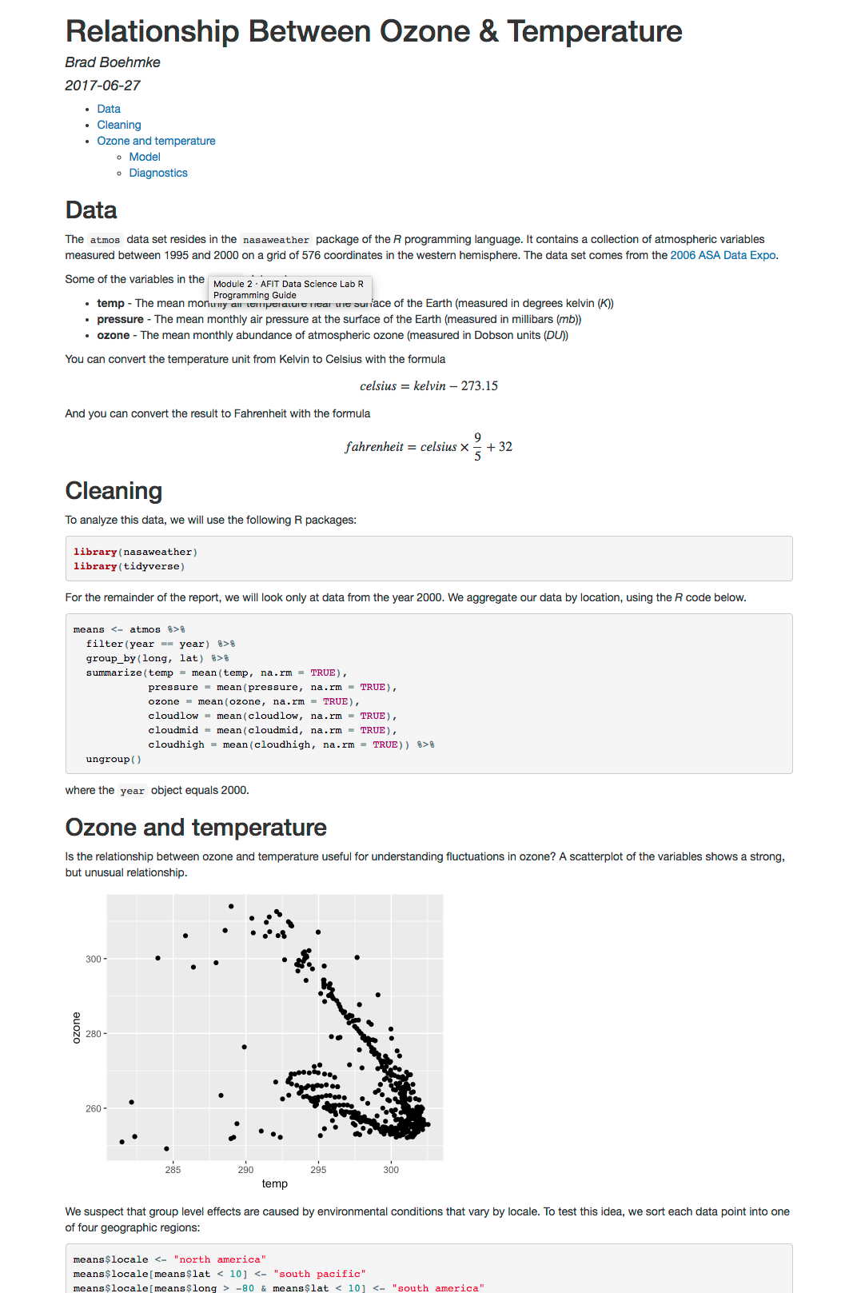
yaml
15. Add remaining text and code chunks.
16. Change the YAML header to:
---
title: "Relationship Between Ozone & Temperature"
author: "Tianhai Zu"
date: "`r Sys.Date()`"
output:
html_document:
toc: true
---

Slide 49
different outputs
Render as an HTML, PDF, and Word document
Change the YAML header to:
---
title: "Relationship Between Ozone & Temperature"
author: "Tianhai Zu"
date: "`r Sys.Date()`"
output: slidy_presentation
---
Default is to generate slides based on 2nd level headings but you can add *** anywhere and it will create a new slide there.

Slide 50
How to: format data tables
Use the knitr::kable() function to display a table with additional formatting
Look at documentation for LOTS of options
# code chunk example
# What will this code chunk do?
```{r echo = FALSE}
knitr::kable(
airquality[1:10, ],
caption = "What a cool table format!"
)
```

Slide 51

How to: Cache Results
Use the code chunk option cache = TRUE to cache results, meaning save chunk output for future use
VERY handy if code take a long time and you need to update/change code
Can use the dependson = … option to run different code without reloading a massive data set
# code chunk example
# What will this code chunk do?
```{r echo = FALSE, cache = TRUE}
data <- read.csv(“some_huge_file.csv”)
data
```

Slide 52
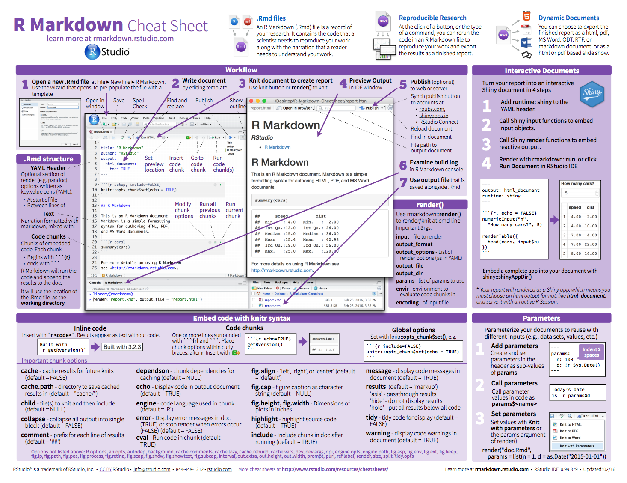
Many options
Help menu >> Cheatsheets

Slide 53

R notebook

Slide 54
why so special?
An R Markdown document that allows for independent and interactive execution of code chunks.
Creates greater interactivity while creating your document
Easy to share your notebook directly
When complete, knit to the publication format desired

Slide 55
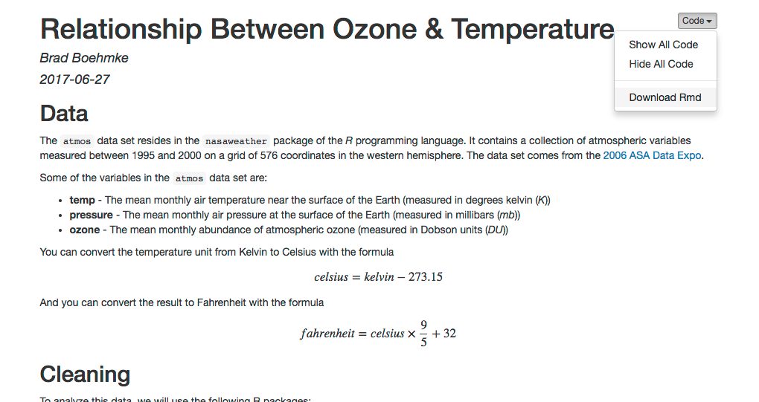
demo
Open “RMarkdown Demonstration Notebook.nb.html” file.
Download Rmd.
Open Rmd in your RStudio, make changes, knit, and send back to your collaborator.

Slide 56

what to remember

Slide 57
what you should know
Topic | Description
R project | Conveniently organizes files pertaining to specific analytic projects
R Markdown | Allows user to combine prose, code, and metadata into one file for to increase reproducibility and reporting capabilities
R Notebook | An R Markdown document that allows for independent and interactive execution of code chunks.

Slide 58


